Slide 1
Networks (Tutorial). Week 2
Muhammad Fahim, Giancarlo Succi, Alexander Tormasov
Innopolis University
m.fahim@innopolis.ru
g.succi@innoplois.ru
a.tormasov@innopolis.ru
January 31, 2019

Slide 2
Topic of the lecture
Computer Networks
Types of Networks
Open Systems Interconnection (OSI) Model
The Application Layer
Application Architecture
Principles of Network Applications
Web and HTTP
FTP
Notes:
Application, Presentation, Session – Transport – Network, Data Link, Physical
APS-T-NDP
APS – Software
T – Heart of OSI
NDP – Hardware layers

Slide 3
Topic of the tutorial
A brief overview of physical and logical topology
The application layer protocol (HTTP)

Slide 4
Topic of the tutorial
The application layer protocol (HTTP)

Slide 5
Network Topology
Geographical representation of the links.
Topology is physical layout of computers, cables and other connected devices on a network.
Types
Physical Topology
Logical Topology

Slide 6
Types of Topology
Physical Topology
Actual layout of the computer cables and other network devices.
Logical Topology
The way in which the network appears to the devices that use it.
Refers to how data is actually transferred in a network.

Slide 7
Selection Criteria
Size (no of node) of the system
Cost of the components and service required
Management of network
Architecture of network
Cable type
Expandability of the network
The desired performance
Reliability

Slide 8
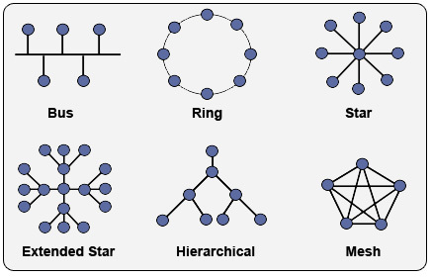
Network Topology
Notes:
MESH: Node-1 must be connected with n-1 nodes.
A fully connected mesh can have n(n-1)/2 physical channels to link n devices.
It must have n-1 i/o ports.
Advantages:
They use dedicated links so each link can only carry its own data load. So traffic problem can be avoided.
It is robust. If any one link get damaged it cannot affect others.
It gives privacy and security.(Message travels along a dedicated link)
Fault identification and fault isolation are easy.
LAN is star topology
Hierarchical: Referred as Star Bus technology.
Even hybrid topology also exist.

Slide 9
What is a Protocol?
In diplomatic circles, a protocol is the set of rules governing a conversation between people
We have seen that the client and server carry on a machine-to-machine conversation
A network protocol is the set of rules governing a conversation between a client and a server
Notes:
Follow protocol – follow the rules of the conversation

Slide 10
Network Protocols
The rules are defined by the inventor of the protocol – may be a group or a single person.
The rules must be precise and complete so programmers can write programs that work with other programs.
The rules are often published as an RFC* along with running client and server programs.
*RFC = request for comments

Slide 11
Application Layer Protocols
Protocol | Application
HTTP: Hypertext Transfer | Retrieve and view Web pages
FTP: File Transfer | Copy files from client to server or from server to client
SMTP: Simple Mail Transport | Send email
POP: Post Office | Read email

Slide 12
Hypertext Transfer Protocol (HTTP)
Tim Berners-Lee added to the Internet to create the World Wide Web had two fundamental dimensions
Connectivity
Interface.
He invented a new protocol for the computers to speak as they exchanged hypermedia documents
A computer that asked for a file from another computer would know, when it received the file, if it was a picture, a movie, or a spoken word.
Notes:
Tim is British scientist while working in CERN – 1989
CERN is European Organization for Nuclear Research and headquarter in Geneva, Swizerland.

Slide 13
Hypertext Transfer Protocol (HTTP)
It is an application-layer protocol for communicating between distributed systems.
It allows for communication between a variety of hosts and clients, and supports a mixture of network configurations.

Slide 14
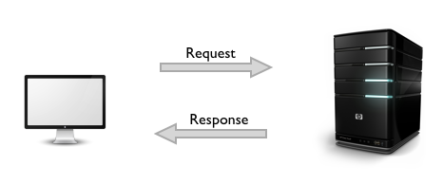
HTTP – Client-Server Architecture
The HTTP protocol is based on a request/response paradigm
The communication usually takes place over TCP/IP, but any reliable transport can be used.
The default port for TCP/IP is 80, but other ports can also be used.
Notes:
TCP – is for connection orientated applications. It has built in error checking and will re transmit missing packets.
UDP – is for connection less applications. It has no has built in error checking and will not re transmit missing packets.
The default port for HTTP is 80 and HTTPS is 443 but a TCP server socket can be associated with any port from 1 to 65535

Slide 15
HTTP – Client-Server Architecture
Client
A client establishes a connection with a server and sends a request in the form of a request method, URI, and protocol version, followed by a message containing request modifiers, client information, and possible body content.
Server
The server responds with a status line, including its protocol version and a success or error code, followed by a message containing server information, entity metainformation, and possible body content.

Slide 16
HTTP Conversation
Client
Server
OK
Send page or error message
OK
I would like to open a connection
GET <file location>
Display response
Close connection
HTTP is the set of rules governing the format and content of the conversation between a Web client and server

Slide 17
HTTP Communication – 1/2
It is a connectionless protocol
The protocol is called connectionless because once the single request has been satisfied, the connection is dropped.
It greatly simplifies the server construction and relieves it of the performance penalties of session housekeeping

Slide 18
HTTP Communication – 2/2
It is a stateless protocol
After the server has responded to the client’s request, the connection between client and server is dropped and forgotten.
There is no “memory” between client connections.
The pure HTTP server implementation treats every request as if it is brand-new

Slide 19
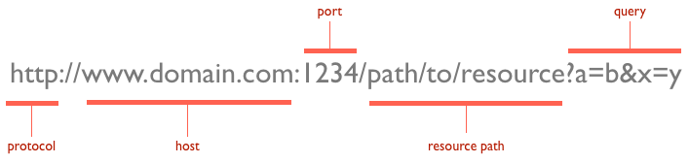
Uniform Resource Locators (URLs)
At the heart of web communications is the request message, which are sent via URLs.
The protocol is typically http, but it can also be https for secure communications.
URLs reveal the identity of the particular host with which we want to communicate, but the action that should be performed on the host is specified via HTTP verbs
Notes:
The default port for HTTP is 80 and HTTPS is 443 but a TCP server socket can be associated with any port from 1 to 65535

Slide 20
Verbs
GET: fetch an existing resource. The URL contains all the necessary information that server needs to locate and return the resource.
POST: create a new resource. It requests usually carry a payload that specifies the data for the new resource.
PUT: update an existing resource. The payload may contain the updated data for the resource.
DELETE: delete an existing resource

Slide 21
Verbs
HEAD
Similar to GET, but without the message body.
Usage: generally to check if the resource has changed, via timestamps.
TRACE
It is used to retrieve the hops that a request takes to round trip from the server.
This can be used for diagnostic purposes.
OPTIONS
It is used to retrieve the server capabilities.
On the client-side, it can be used to modify the request based on what the server can support.
Notes:
Trace is usually, disabled because of the security issues.

Slide 22
Status Codes
1xx: Informational Messages
All HTTP/1.1 clients are required to accept the Transfer-Encoding header.
2xx: Successful
202 Accepted: the request was accepted but may not include the resource in the response.
204 No Content: there is no message body in the response.
205 Reset Content: indicates to the client to reset its document view.
206 Partial Content: indicates that the response only contains partial content. Additional headers indicate the exact range and content expiration information.
Notes:
The server can send a Expect: 100-continue message, telling the client to continue sending the remainder of the request, or ignore if it has already sent it.
HTTP/1.0 clients are supposed to ignore this header.

Slide 23
Status Codes
3xx: Redirection
301 Moved Permanently: the resource is now located at a new URL.
303 See Other: the resource is temporarily located at a new URL. The Location response header contains the temporary URL.
304 Not Modified: the server has determined that the resource has not changed and the client should use its cached copy. This relies on the fact that the client is sending ETag (Enttity Tag) information that is a hash of the content. The server compares this with its own computed ETag to check for modifications.

Slide 24
Status Codes
4xx: Client Error
400 Bad Request: the request was malformed.
401 Unauthorized: request requires authentication. The client can repeat the request with the Authorization header. If the client already included the Authorization header, then the credentials were wrong.
403 Forbidden: server has denied access to the resource.
405 Method Not Allowed: invalid HTTP verb used in the request line, or the server does not support that verb.
409 Conflict: the server could not complete the request because the client is trying to modify a resource that is newer than the client's timestamp. Conflicts arise mostly for PUT requests during collaborative edits on a resource.

Slide 25
5xx: Server Error
501 Not Implemented: the server does not yet support the requested functionality.
503 Service Unavailable: this could happen if an internal system on the server has failed or the server is overloaded. Typically, the server won't even respond and the request will timeout.

Slide 26
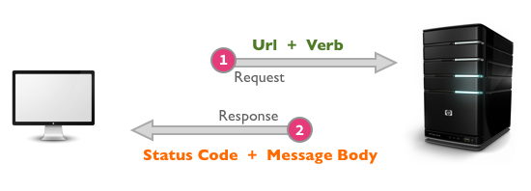
Request and Response Message Formats

Slide 27
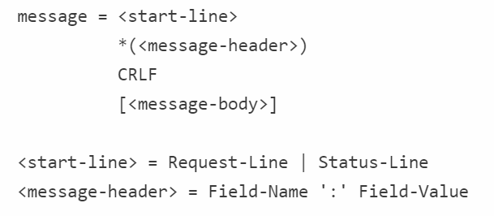
Message Structure
The message can contain one or more headers, of which are broadly classified into:
General headers: that are applicable for both request and response messages.
Request specific headers.
Response specific headers.
Entity headers.
Notes:
CRLF -- It's mandatory to place a new line between the message headers and body.
CRLF: Carriage Return Line Feed

Slide 28
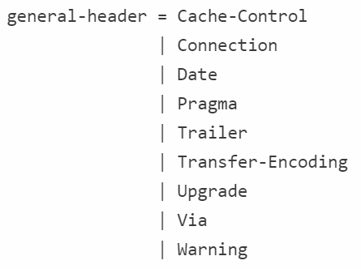
Message Header
Notes:
Pragma is considered a custom header and may be used to include implementation-specific headers. The most commonly used pragma-directive is Pragma: no-cache, which really is Cache-Control: no-cache under HTTP/1.1.
The Date header field is used to timestamp the request/response message
Upgrade is used to switch protocols and allow a smooth transition to a newer protocol.
Transfer-Encoding is generally used to break the response into smaller parts with the Transfer-Encoding: chunked value.
The Trailer response header allows the sender to include additional fields at the end of chunked messages in order to supply metadata

Slide 29
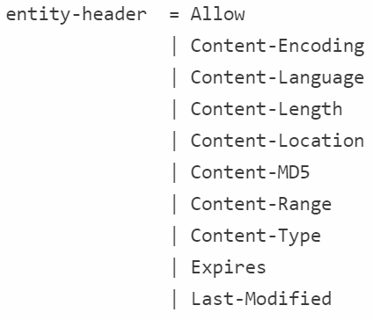
Entity Headers
Request and Response messages may also include entity headers to provide meta-information about the content
Notes:
All of the Content- prefixed headers provide information about the structure, encoding and size of the message body. Some of these headers need to be present if the entity is part of the message.
The Expires header indicates a timestamp of whent he entity expires. Interestingly, a "never expires" entity is sent with a timestamp of one year into the future. The Last-Modified header indicates the last modification timestamp for the entity.
Custom headers can also be created and sent by the client; they will be treated as entity headers by the HTTP protocol.
This is really an extension mechanism, and some client-server implementations may choose to communicate specifically over these extension headers. Although HTTP supports custom headers, what it really looks for are the request and response headers, which we cover next.

Slide 30
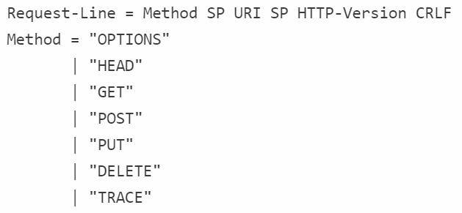
Request Format
Notes:
SP is the space separator between the tokens. HTTP-Version is specified as "HTTP/1.1" and then followed by a new line.

Slide 31
HTTP Request Message: General Format
method
sp
URL
sp
version
cr
lf
request
line
header field name
value
cr
lf
~
~
header
lines
~
~
header field name
value
cr
lf
cr
lf
~
entity body
~
body
~
~

Slide 32
HTTP Request Message
Two types of HTTP messages: request, response
HTTP request message:
ASCII (human-readable format)
carriage return character
request line
(GET, POST,
HEAD commands)
line-feed character
GET /index.html HTTP/1.1\r\n
Host: www-net.cs.umass.edu\r\n
User-Agent: Firefox/3.6.10\r\n
Accept: text/html,application/xhtml+xml\r\n
Accept-Language: en-us,en;q=0.5\r\n
Accept-Encoding: gzip,deflate\r\n
Accept-Charset: ISO-8859-1,utf-8;q=0.7\r\n
Keep-Alive: 115\r\n
Connection: keep-alive\r\n
\r\n
header
lines
carriage return,
line feed at start
of line indicates
end of header lines

Slide 33

Response Format
HTTP-Version is sent as HTTP/1.1
The Status-Code is one of the many statuses discussed earlier.
The Reason-Phrase is a human-readable version of the status code.
Example: It looks like:

Slide 34
HTTP Response Message
status line
(protocol
status code
status phrase)
HTTP/1.1 200 OK\r\n
Date: Sun, 26 Sep 2010 20:09:20 GMT\r\n
Server: Apache/2.0.52 (CentOS)\r\n
Last-Modified: Tue, 30 Oct 2007 17:00:02 GMT\r\n
ETag: "17dc6-a5c-bf716880"\r\n
Accept-Ranges: bytes\r\n
Content-Length: 2652\r\n
Keep-Alive: timeout=10, max=100\r\n
Connection: Keep-Alive\r\n
Content-Type: text/html; charset=ISO-8859-1\r\n
\r\n
data data data data data ...
header
lines
data, e.g.,
requested
HTML file
Notes:
Keeep-alive: timeout 10, max: mean maximum number of requests

Slide 35
Server-side Connection Handling
The operations involve:
Establishing a socket to start listening on port 80 (or some other port)
Receiving the request and parsing the message
Processing the response
Setting response headers
Sending the response to the client
Close the connection if a Connection: close request header was found
Notes:
A socket is bound to a port number so that the TCP layer can identify the application that data is destined to be sent to.

Slide 36
HTTP/1.1 - The Next Generation
The HTTP/1.1 (RFC 2616), is a replacement for HTTP/1.0
It has higher performance and adding some extra features needed for use in commercial applications.
It’s designed to make it easy to implement the basic functionality needed by all browsers
Additionally, more powerful features such as
Security and authentication much simpler.
Notes:
RFC = Request for Comments

Slide 37
HTTP/1.1 - The Next Generation
Persistent Connections
A client and a server can signal the close of a TCP connection.
This signaling takes place using the Connection header field
Prior to persistent connections:
A separate TCP connection was established to fetch each URL
It increase the load on HTTP servers and causing congestion on the Internet.

Slide 38
HTTP/1.1 - The Next Generation
Persistent Connections (Advantages)
By opening and closing fewer TCP connections, CPU time is saved in routers and hosts
Network congestion is reduced by reducing the number of packets caused by TCP opens (handshakes’ cost)
Latency on subsequent requests is reduced since there is no time spent in TCP’s connection opening handshake.
It can evolve more gracefully, since errors can be reported without the penalty of closing the TCP connection.

Slide 39
HTTP/1.1 - The Next Generation
Request Pipelining
Allows a client to send several requests without waiting for a response
Server responds in the same order
Chunked Encoding
Allows sender to break a message into arbitrary sized chunks
Useful for dynamically created response messages
Notes:
Pipelining allows a client to make multiple requests without waiting for each response, allowing a single TCP connection to be used much more efficiently, with much lower elapsed time.

Slide 40
SSL: Secure Web Communications
*SSL protocol is application independent
Operates between application layer and transport layer
Application protocols such as HTTP sit on top of it and TCP/IP beneath it
*Secure Sockets Layer are cryptographic protocols designed to provide communications security over a computer network.
Notes:
Secure Sockets Layer are cryptographic protocols designed to provide communications security over a computer network.

Slide 41
Ensuring SSL version compatibility
There are different versions of SSL depending on the encryption algorithm used.
The browser sends the versions it supports
The server sends the certificate. The certificate includes:
The identity of the organization to which the web server belongs
The certificate’s expiration date
The public key
The identity of the organization that issued the certificate, known as a certification authority (CA)
Browsers store and recognize certificates issued by a number of well-known CAs.

Slide 42
Reference
This tutorial is based on the following documents as well as lecture materials over the internet.
http://condor.depaul.edu/dmumaugh/readings/handouts/SE435/HTTP/http.pdf
https://code.tutsplus.com/tutorials/http-the-protocol-every-web-developer-must-know-part-1--net-31177

